Slide 1
Zelera Deck
Where Growth Begins

Slide 2
Introduction
Zelera Deck transforms local shops into polished mobile storefronts that sell 24/7.
Launch quickly, engage customers via \u{200B}*WhatsApp orders*\u{200B}, and keep full control of your profits without tech headaches.

Slide 3
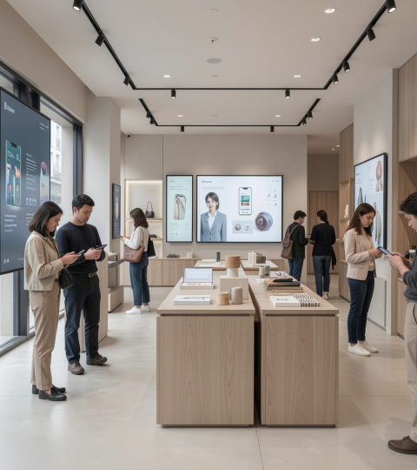
02
Store Digitization

Slide 4
Mobile-first storefront
Design a clean, responsive shop optimized for smartphones so customers browse anytime, anywhere.
Shareable links and beautiful product pages convert casual viewers into buyers. Mobile-first presence increases sales.

Slide 5
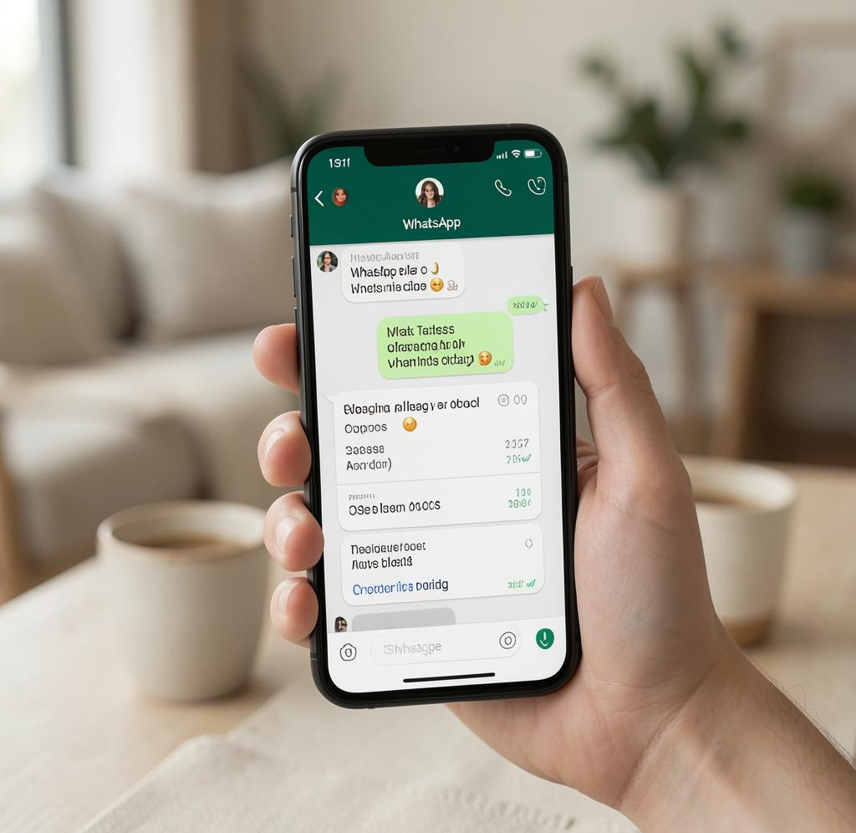
WhatsApp ordering
Customers place orders directly through WhatsApp for instant, personal transactions.
No complex checkouts—just clear messages that speed confirmations and reduce abandoned sales. Direct conversion.

Slide 6
No technical skills
If you use WhatsApp or Facebook, you can run Zelera Deck—no coding needed.
Manage items, prices, and stock from your phone in seconds, keeping operations simple and fast.

Slide 7

03
Pain Points

Slide 8
Cost of websites
Traditional websites demand high upfront fees and ongoing costs that strain small budgets.
Zelera Deck offers predictable, affordable plans so you modernize without sacrificing margins.

Slide 9
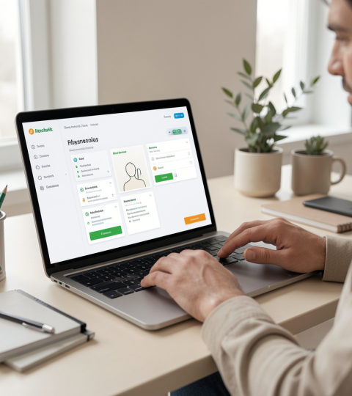
Technical complexity
Complex platforms require specialists and time-consuming maintenance.
Our intuitive dashboard removes that barrier—spend minutes updating your shop, not hours learning tools.

Slide 10
Slow updates
Traditional sites need lengthy edits and developer help, causing delayed product listings and lost sales.
With slow workflows, customers see outdated stock or prices—resulting in missed opportunities and frustration.

Slide 11

03
Zelera Solution

Slide 12
Easy dashboard controls
A clear mobile dashboard lets you update items, prices, and availability in seconds from your phone.
One-click status changes keep customers informed and reduce order disappointments. Fast management.

Slide 13
Direct customer chat
Orders come through WhatsApp, creating instant, personal conversations that convert quickly.
Skip complex checkouts—respond, confirm, and close sales in real time for better customer trust.

Slide 14

0% commission
Zelera Deck charges no commission—keep every rupee you earn.
Pay a simple subscription instead and retain full control of pricing and customer relationships. Full profit retention.

Slide 15
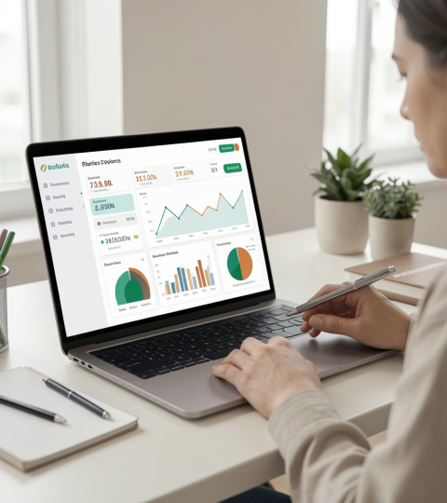
04
Pricing & Growth

Slide 16
Launch offer details
Start with the launch deal: ₹1,599 for the first 3 months to get your shop live fast.
Low-cost entry reduces risk while you test digital sales and reach more customers.

Slide 17
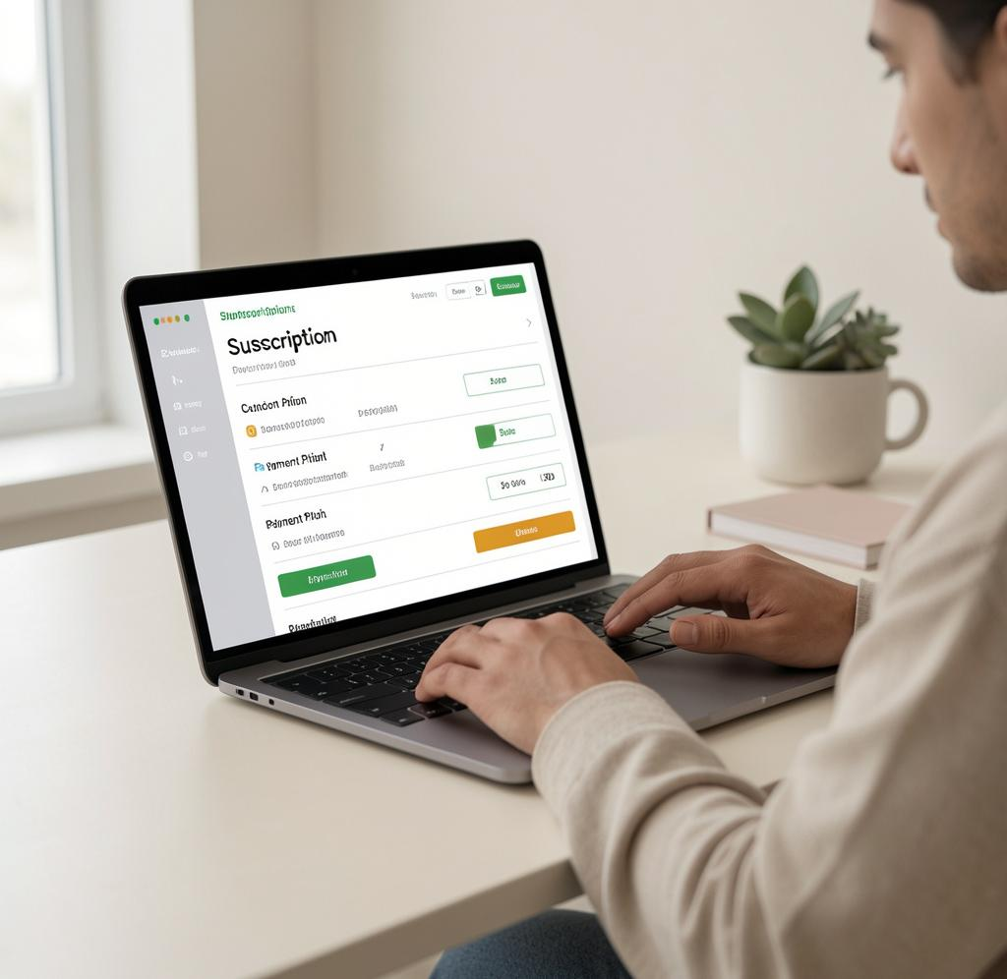
Ongoing plan price
After the trial, continue for just ₹699/month to maintain your digital storefront and updates.
Predictable pricing helps you plan growth without surprise fees.

Slide 18
Share & promote
Your custom shop link is ready to share on Instagram, Facebook, and WhatsApp statuses to reach followers.
Simple sharing turns social presence into steady sales with minimal effort.

Slide 19
Conclusions
Zelera Deck makes digitization simple, affordable, and profitable for local shops.
Launch quickly, keep full profits, and convert customers with direct WhatsApp orders—modern retail without the tech hassle.

Slide 20
Thanks!
Do you have any questions?
youremail@freepik.com
+34 654 321 432
yourwebsite.com
Please keep this slide for attribution

